Slide 1
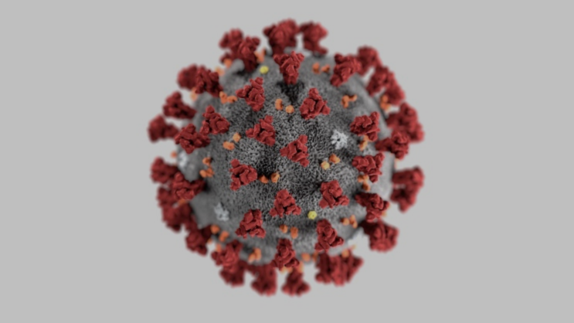
Covid - 19 Facts
4 696 849 Confirmed cases world wide WHO 19/05/20
315 131 Confirmed deaths world wide WHO 19/05/20
216 Countries with cases
Part of a family of virus’s which can cause illness in animals and humans leading to a variety of respiratory infections
Note Symptoms are usually mild and begin- fever, dry cough, fatigue/ tiredness. Less common symptoms aches and pains, nasal congestion. Sore throat, loss of taste and smell.
Some research indicates that the virus can be transmitted by people who are asymptomatic
Approximately 80% of people recover without needing treatment in hospital. 1/5 people become seriously ill and develop breathing difficulties.
On surfaces the virus can be cleaned by household disinfectants
Several dogs and cats have been tested positive with Corona Virus – how ever there is no evidence to suggest that they can transmit the disease
COVID-19 affects more elderly individuals than youth and more men than women, and the severity and death rate are also higher in elderly individual than in youth.
Notes:
from the common cold to Severe Respiratory Syndrome (SARS) Covid 19 is a type of corona virus.
Death percentage

Slide 2
The Coronavirus Explained
https://www.youtube.com/watch?v=BtN-goy9VOY

Slide 3
Current CSP guidelines
In line with current UK-wide advice all non-essential health and social care delivery must stop- community care must consider remote consultations
Using professional judgement- regarding appropriate consultation method
Notes:
Providers of all community care must consider if remote consultations can allow for services to be provided without any physical interaction. See our FAQ 'Face to face or not' on when it may be necessary to follow-up remote consultations with face-to-face. Members working in non-essential services are likely to be made available to assist with essential services as per local need
Clinicians should use their professional judgement to make decisions about the most appropriate consultation method on an individual basis.

Slide 4
CSP Covid Rehabilitation Standards
1 Assessment and goal setting
2 Timing and intensity of rehabilitation
3 Continuity of care and communication
4 Ongoing rehabilitation in the community
5 Personal Protective Equipment (PPE) and infection control during rehabilitation
Notes:
1- initaial assessmenr takes place as soon as possible in an inpatient setting. Includes prognososis, risk, co-morbidities. Phsyio is part of a full MDT assessment
Short term and medium goals are documented – a holistic individual plan must be put in place.
2. Starts as soon as possible. MDT descion of when to start rehab taking into account medical status. Starting rehab early improves physical, psychological and emotional outcomes and prevent future problems. How ever most covid patients have complicated clinical prsentations therefore decision of when to start must be an mdt decision. Patient hwo are critically ill can deteriorate rapidly. Fatigue, breathlessness and o2 desaturatuin and common symptoms and are monitored.
Goals and plans shoulde be communicated along there care planway to team responsible for their care. Discharge planning – ongoing care requirments. Equipment provision- communication is key to stop slowing recovery.
4. Delvivered by mist appropriate team. – assements will take palce to asses which team they will to progress to wads rehab goals
5.

Slide 5
MSK conditions post covid
Brachial plexus injury and neck potential neck pain
Effect of long period of immobility general Deconditioning on a long ITU stay i.e. decreased muscle mass and bone density within 1 weeks of bed rest
Exacerbation of previous underlying MSK conditions
Notes:
https://www.ncbi.nlm.nih.gov/pmc/articles/PMC4600281/

Slide 6
Signs of respiratory distress
Increased work of breathing
Colour changes
Assessory muscles
and body position
Voice
Limited exercise tolerance
Grunting, wheezing
Nose flaring
Notes:
Consider PMH ?COPD what is normal for them?

Slide 7
Notes:
Referrals on

Slide 8
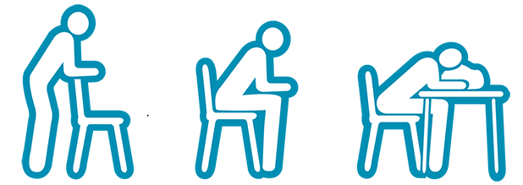
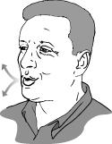
Advice and Treatments
Borg scale of breathlessness
Pacing
Reassurance – anxiety
Positions of ease
Relaxation breathing
Purse lip breathing
Basic stretches
Exercises
ACBT
Notes:
l Plan ahead l Avoid the Boom-Bust Cycle l Pace yourself l Use breathing exercises l Sit during tasks and activities l Minimise arm movements l Avoid bending, reaching, twisting l Use good posture l Use good body mechanics
It is important to remember that conserving energy is not about avoiding exercise.
Energy conservation is about making everyday tasks easier and it will allow you to have some energy left for exercise. Exercise is important to increase your fitness and improve your health. Being fitter will help you manage tasks and chores more easily
Avoid fatigue l Get enough rest l Do not wait until you are tired before you stop and rest l Try to have a rest or lie down for a short time in the afternoon to recover some of the energy used during morning activities l Avoid hurrying or rushing l Avoid large meals l Avoid activities for 1 hour after meals

Slide 9
Resources
https://www.who.int/emergencies/diseases/novel-coronavirus-2019/question-and-answers-hub/q-a-detail/q-a-coronaviruses
https://www.youtube.com/watch?v=BtN-goy9VOY
https://www.csp.org.uk/news/coronavirus/workplace-employment/workplace-faqs
https://www.csp.org.uk/news/coronavirus/workplace-employment/workplace-faqs
https://www.csp.org.uk/system/files/publication_files/001745_Covid-19%20Rehab%20Standards.pdf

