Slide 1
Brachial plexus injuries and Covid-19

Slide 2
Aims
To discuss current pathologies post Covid-19 relevant to physiotherapy
To review prone positioning and brachial plexus injury link
To review brachial plexus anatomy and presentation
Physiotherapy treatment
Review current guidelines from Stanmore

Slide 3
Reason for current presentation
Recent studies of patients with severe Covid-19 who have been hospitalised on ventilators have shown lying face down is better for the lungs
The study has found alternating supine and prone positioning is associated with increased lung recruitability compared to those who did not receive prone positioning and had poor lung recruitability
Patients are spending prolonged periods in a prone position. There are risks associated with this include brachial plexus related injuries
The national nerve injury unit (Stanmore) are getting a lot of queries about management of these patients and have developed recommendations to guide further treatment of patients who are getting altered upper limb neurology or Prone Position Plexopathy (PPP)
Notes:
The study was completed in Wuhan, China, for the treatment of 12 patients and was over a periods of 6 days
Patients with persistently low levels of oxygen were put in a prone position for a 24 hour period
3 patients died

Slide 4
Brachial plexus anatomy
The brachial plexus is a network of nerve fibres that supplies the skin and musculature of the upper limb
Begins in the root of the neck, passes through the axilla, and runs through the entire upper extremity
The plexus is formed by the divisions of C5, C6, C7 and C8, and T1
The brachial plexus is divided into five parts; roots, trunks, divisions, cords and branches (a good mnemonic for this: Read That Damn Cadaver Book)
In the axilla and the proximal aspect of the upper limb, the three cords give rise to five major branches.
The 5 major branches are the: the musculocutaneous nerves, axillary, median, radial and ulnar nerve
There are also small nerve which come off the brachial plexus at different areas e.g. dorsal scapula nerve, long thoracic nerve
Notes:
The nerves pass between the anterior and medial scalene muscles to enter the base of the neck.

Slide 5
Anatomy video
https://www.youtube.com/watch?v=5YJJkK4Kw88

Slide 6
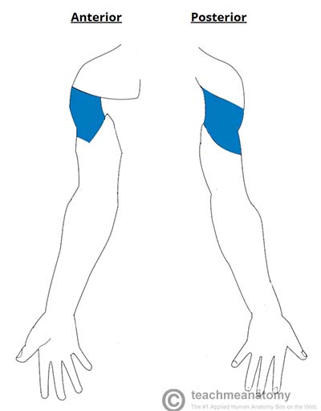
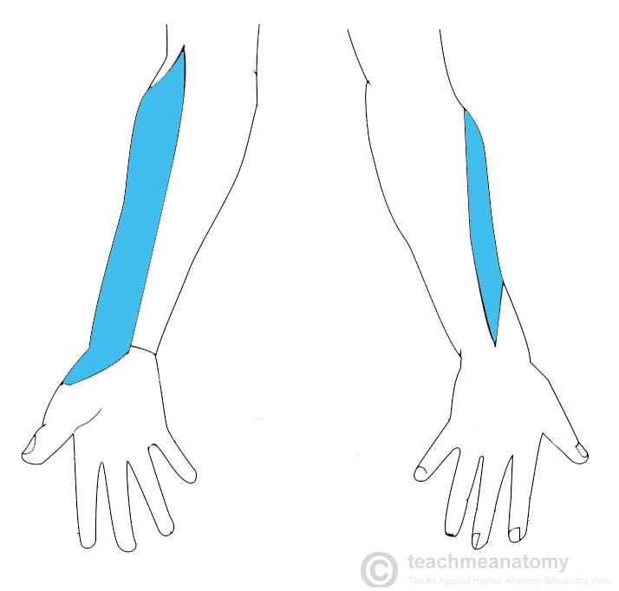
Musculocutaneous Nerve
Roots: C5, C6, C7.
Motor Functions: Innervates the brachialis, biceps brachii and coracobrachialis muscles.
Sensory Functions: Gives off the lateral cutaneous branch of the forearm, which innervates the lateral half of the anterior forearm, and a small lateral portion of the posterior forearm.
Axillary Nerve
Roots: C5 and C6.
Motor Functions: Innervates the teres minor and deltoid muscles.
Sensory Functions: Gives off the superior lateral cutaneous nerve of arm, which innervates the inferior region of the deltoid (“regimental badge area”).

Slide 7
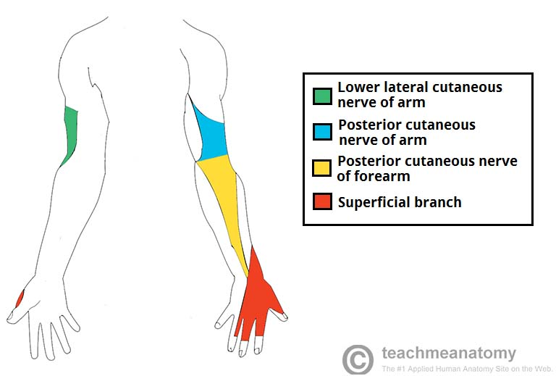
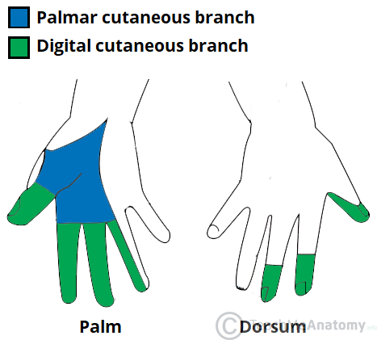
Median Nerve
Roots: C6 – T1. (Also contains fibres from C5 in some individuals).
Motor Functions: Innervates most of the flexor muscles in the forearm, the thenar muscles, and the two lateral lumbricals associated with the index and middle fingers.
Sensory Functions: Gives off the palmar cutaneous branch, which innervates the lateral part of the palm, and the digital cutaneous branch, which innervates the lateral three and a half fingers on the anterior (palmar) surface of the hand.
Radial Nerve
Roots: C5 – T1.
Motor Functions: Innervates the triceps brachii, and the muscles in the posterior compartment of the forearm (which are primarily, but not exclusively, extensors of the wrist and fingers).
Sensory Functions: Innervates the posterior aspect of the arm and forearm, and the posterolateral aspect of the hand.

Slide 8
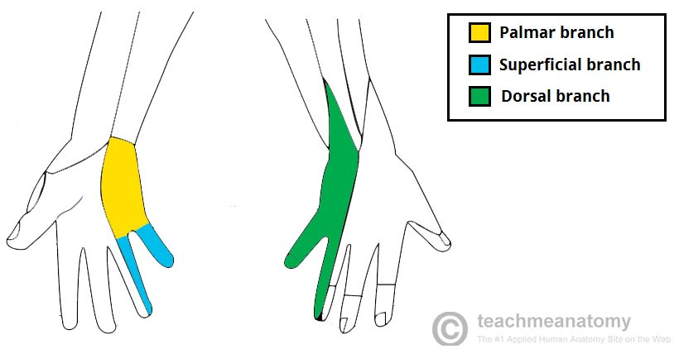
Ulnar Nerve
Roots: C8 and T1.
Motor Functions: Innervates the muscles of the hand (apart from the thenar muscles and two lateral lumbricals), flexor carpi ulnaris and medial half of flexor digitorum profundus.
Sensory Functions: Innervates the anterior and posterior surfaces of the medial one and half fingers, and associated palm area.

Slide 9
Causes of brachial plexus injuries
Prone lying for prolonged periods with patient who have Covid-19
Traction due to extreme movements and heavy impact
Shoulder trauma or surgeries
Tumours
Inflammation
Obstetric injuries during birth e.g. excessive stretching of the neck or pulling the upper extremity
Vascular injuries

Slide 10
Signs and symptoms
Weakness
Numbness
Altered sensation
Loss of movement
Pain- electric shock/burning sensation down arm
Longer term patients can suffer with stiffness in joints, muscle atrophy, pain becoming more chronic, permanent numbness and permanent loss in function

Slide 11
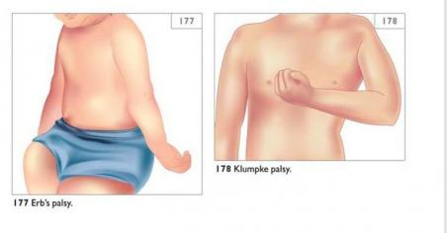
Presentation
Upper brachial plexus lesion
Occurs from excessive lateral neck flexion away from the shoulder
Forceps delivery or falling on the neck at an angle causes upper plexus lesion
Leads to Erb's Palsy
Produces a Waiter's tip deformity due to loss of the lateral rotators of the shoulder, arm flexors, and hand extensor muscles.
Lower brachial plexus lesion
Infrequently
Sudden upward pulling on an abducted arm e.g. grasping a tree branch suddenly when falling
C8 and T1 injured
Paralysis affects the intrinsic muscles of the hand and the flexors of the wrist and fingers
Results in a form of paralysis known as Klumpke's Paralysis

Slide 12
Treatment
Depends on the severity
Physiotherapy aim is to develop strength, ROM and co-ordination
Positioning and splinting may be required in some cases
Functional training
Acupuncture
TENS machine
Managing chronic odema (education, compression garments, massage therapy)
Neuropathic medication e.g. NSAID's, neuropathics
Surgery in some cases
Psychological well being and management

Slide 13
Exercises
May include:
Scapula stability
Off loading
Biceps/triceps/wrist strengthening
Grip strength
Nerve glides

Slide 14
Physiotherapy treatment/exercises
ROM: Assisted, Active Assisted, Active.
Graded progressive strengthening
Strength: Isometric, Eccentric, Concentric.
Manual Therapy Techniques: Cx distraction, soft tissue massage, Collar & Cuff, Taping, Nerve Glides/slides.

Slide 15
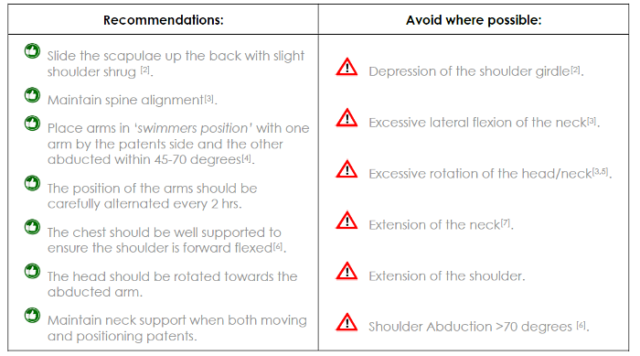
Current treatment/Recommendations in line with Covid-19
From the royal orthopaedic association – Stanmore

Slide 16
Notes:
Patients who do not recover function within 3 weeks of the symptoms being identifie must be referred to a centre for nerve injury Any patients who report the presence of neuropathic pain or a total loss of function of one nerve branch (no sympathetics, sensation or motor) require urgent treatment.

Slide 17
Suggested clinical examination tool

Slide 18
Resources used
https://www.gmjournal.co.uk/covid-19-prone-position-in-icu-better-for-lungs
https://www.boa.ac.uk/policy-engagement/journal-of-trauma-orthopaedics/journal-of-trauma-orthopaedics-and-coronavirus/a-commentary-on-prone-position-plexopathy.html
https://teachmeanatomy.info/upper-limb/nerves/brachial-plexus/
https://www.physio-pedia.com/Brachial_plexus
https://www.mayoclinic.org/diseases-conditions/brachial-plexus-injury/symptoms-causes/syc-20350235
https://pedclerk.bsd.uchicago.edu/page/brachial-plexus-injury

