Slide 1
Osteoarthritis of the Hip, Knee, and Ankle
CAMBRIDGESHIRE Community Services -Dynamic Health
What is osteoarthritis?
© DynamicHealth part of Cambridgeshire Community Service NHS Trust 2018 All rights reserved

Slide 2
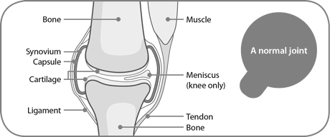
What is Osteoarthritis?
Osteoarthritis is a condition that affects your joints.
The surfaces within your joints have changed so the joint doesn’t move as smoothly as it should.
All the tissues within the joint become more active than normal.
Form bony spurs called osteophytes.
The synovium may swell and produce extra fluid.
Capsule and ligaments slowly contract.
© DynamicHealth part of Cambridgeshire Community Service NHS Trust 2018 All rights reserved
Notes:
Osteoarthritis is a condition that affects the joints, causing pain and stiffness. The surfaces within your joints change over time so the joint is no longer able to move as smoothly as it had previously. It is by far the most common form of joint condition and is often referred to as degeneration or wear and tear.
When a joint develops osteoarthritis some of the cartilage covering the ends of the bones gradually roughens and becomes thin. All the tissues within the joint become more active than normal – as your body is trying to repair the joint, therefore a number of adaptations occur:
The bone at the edge of the joint grows outwards, forming bony spurs called osteophytes.
The synovium may swell and produce extra fluid, which then causes the joint to swell.
The capsule and ligaments slowly thicken and contract as if they were trying to stabilise the knee.

Slide 3
How is osteoarthritis Diagnosed
It is very important to have an accurate diagnosis:
Osteoarthritis is usually diagnosed based on your symptoms.
X-ray are taken to assess the severity of the changes caused by osteoarthritis.
Rarely, an MRI scan of you knee or hip can be helpful.
© DynamicHealth part of Cambridgeshire Community Service NHS Trust 2018 All rights reserved
Notes:
There are many different types of arthritis and as such it is important to have an accurate diagnosis to confirm the appropriate management plan for your condition.
Osteoarthritis is usually based on your symptoms:
These may include:
Tenderness over the joint.
Creaking in the joint, known as crepitus.
Swelling.
Restricted movement.
Joint instability.
Weakness and thinning of your thigh or surrounding musculature.
X-rays may be taken to assess the severity of the changes caused by osteoarthritis, although often they won’t be required. They may show changes such as bony spurs or narrowing of the space between the bones where the cartilage has worn thin, however, x-rays aren’t a good indicator of how much pain or limitations you are likely to have. Some people have a lot of pain from fairly minor changes, while others have little pain from more severe adaptations.
An MRI scan of your knee is rarely helpful.

Slide 4
What are the Symptoms are Osteoarthritis?
The symptoms of osteoarthritis can include:
Pain.
Stiffness.
Noisy joints.
Swelling.
Locking of the joint.
Weakness
© DynamicHealth part of Cambridgeshire Community Service NHS Trust 2018 All rights reserved
Notes:
Looking at your symptoms in more detail:
The pain tends to be worse when you move the joint or at the end of the day. You may have pain all around your joint or just in a particular place and it may be worse after a particular movement. The pain is usually better when you rest. Some people have pain that wakes them up at night. You’ll probably find that your pain will vary and that you have good days and bad days, sometimes depending on how active you’ve been but on occasions for no obvious reason.
You may feel stiff at certain times, often in the mornings or after a period of rest. Walking for a few minutes will usually ease it. However, many people don’t have stiffness at all.
You may notice that your joint looks swollen.
The muscles at the front of your thigh that help straighten your knee may look thin and wasted. Sometimes the joint gives way, either because the muscles have become weak or because the joint structure has become less stable.
It’s important to remember that symptoms will be different for everyone, even if the same amount of osteoarthritic change has taken place, therefore, each joint and the subsequent symptoms should be managed individually.

Slide 5
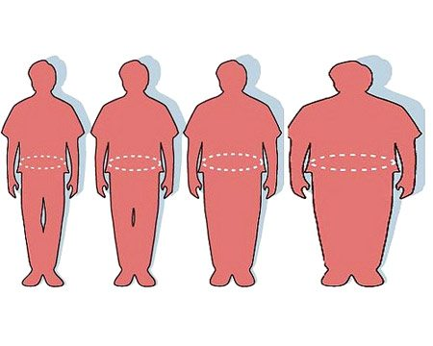
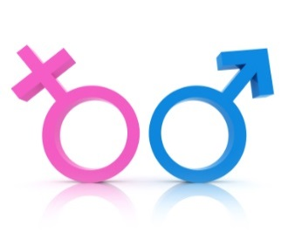
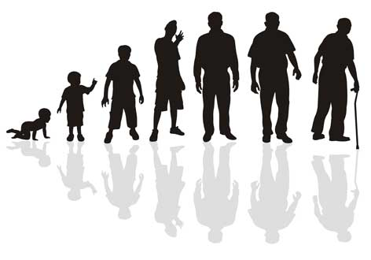
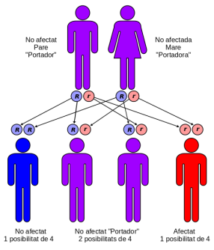
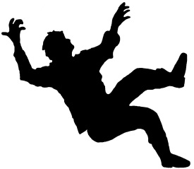
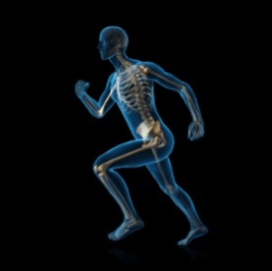
Obesity
Gender
Age
Risk of Osteoarthritis
Genetic factors
Previous injury
Biomechanics
© DynamicHealth part of Cambridgeshire Community Service NHS Trust 2018 All rights reserved
Notes:
There are many risk factors that can increase the risk of osteoarthritis, and its often a combination that leads to the condition.
Age – osteoarthritis usually starts from the late 40s onwards. We don’t fully understand why it’s more common in older people, but it might be due to factors like weakening of the muscles, the body being less able to heal itself or gradual wearing out of the joint with time.
Gender – osteoarthritis is twice as common in women as in men.
Obesity – being overweight is an important factor when considering the risk of osteoarthritis. It also increases the chances of osteoarthritis becoming progressively worse.
Joint injury – Very hard repetitive activity or demanding jobs can increase risk. Injuries to the joints often lead to osteoarthritis in later life. Any operation to remove any damaged cartilage, or repair ligaments also increases the risk of osteoarthritis in later life.
Genetic factors play a major part in osteoarthritis. If you have a family member with osteoarthritis, then you’ll be at higher risk of developing it yourself.
Biomechanics – This is particularly pertinent for those with foot and ankle osteoarthritis; however it is still important to understand for those who have hip and knee osteoarthritis. Many of us will have mild deformities, such as bowed leg, one leg longer than the other, or torsion in the pelvis. While this may not appear to have a detrimental impact, the body must compensate for these abnormalities when we stand, walk or run. Additional problems such as very high or low foot arches, limb length discrepancy or a sports injury can result in compensatory movement when extra stress is placed upon joints, muscles and ligaments.

Slide 6
Understanding Pain
© DynamicHealth part of Cambridgeshire Community Service NHS Trust 2018 All rights reserved
Notes:
We have just covered what is osteoarthritis, and what are the signs and symptoms. However, there is another important element to consider and that is ‘Pain’ – what is it, what are our beliefs about pain and how this might have either a positive or negative impact on your symptoms and also quality of life.

Slide 7
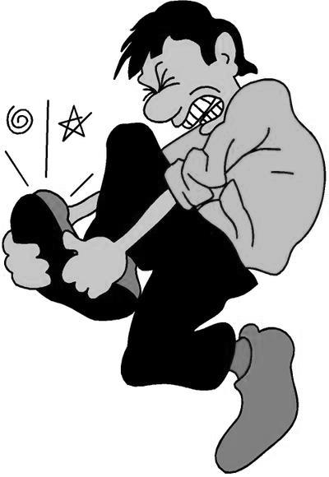
What is Pain?
“Pain is an emotion experienced in the brain, it is not like touch, taste, sight, smell or hearing. It is categorized into:
Acute pain - less than twelve weeks duration.
Chronic pain - of more than twelve weeks.
Pain can be perceived as a warning of potential damage, but can also be present when no actual harm is being done to the body” (British Pain Society).
© DynamicHealth part of Cambridgeshire Community Service NHS Trust 2018 All rights reserved
Notes:
Pain it is an emotion experienced in the brain, it is not like touch, taste, sight, smell or hearing. And it can be categorised into:
Acute pain – less than twelve weeks in duration.
Chronic pain – or more than twelve weeks in duration.
Pain can be perceived as a warning or potential damage, but it can also be present when no actual harm is being done to the body. Some examples of this is stubbing your toe, having a terrible headache or when you get a paper cut. They can be extremely painful but rarely amount to any tissue damage. This should be reassuring to anyone suffering with the symptoms of osteoarthritis as it shows us that the amount of pain you experience does not directly correlate with the amount of adaptation happening within your joint.

Slide 8
© DynamicHealth part of Cambridgeshire Community Service NHS Trust 2018 All rights reserved
Notes:
There are many factors that can contribute to pain, which we term a cycle of chronic pain.
We know that the degree of change to the joints does not directly link to the amount of pain that you feel, however you are likely to still experience varying levels of pain dependent on your current activity levels, mood and many other factors.
Fear of injury and movement can increase the pain. People who avoid this movement due to the fear of pain will become less active and weaker/stiffer over time, and the pain will slowly increase.
This leads to deconditioning both physically and mentally, therefore it is very important to continue with an appropriate level of activity and not stop activities altogether.
Everybody has different beliefs. Somebody who believes their joints are becoming damaged due to a certain activity (walking) will feel more pain when doing that activity. Negative beliefs also worsen feelings of pain e.g. thinking that you won’t be able to walk again. Whereas positive beliefs are thinking ‘If I pace myself and carry on with my activities then I will be able to manage my symptoms’.
Moods and feelings can affect pain. Some people feel their pain increases when they are feeling depressed or anxious. This can be a vicious cycle as when peoples pain increases then this in turn can then affect the mood making you feel even more anxious/depressed.

Slide 9
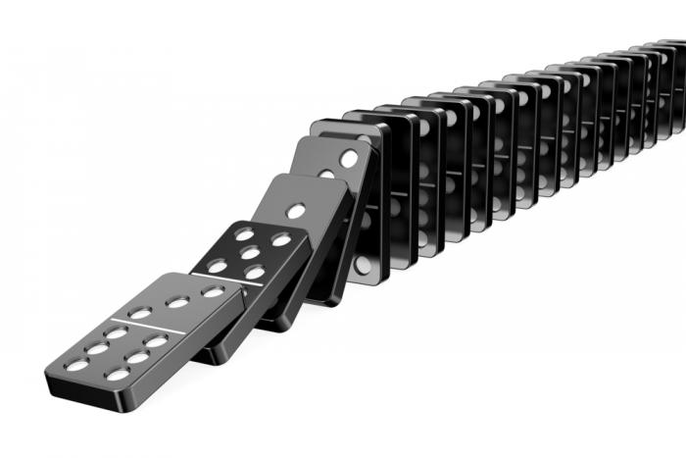
What does this Mean?
Pain during exercise can lead to reduced fitness due to:
Worries of further injury or damage to your joint.
Protecting you joints.
Avoiding unpleasant sensation or pain.
Reduced fitness means activities become harder.
Reduced fitness means more pain as muscles become weaker
and joints become stiffer.
© DynamicHealth part of Cambridgeshire Community Service NHS Trust 2018 All rights reserved
Notes:
So, what does this mean?
Pain during exercises can lead to reduced fitness due to you perhaps feeling that by engaging in activity you may cause further harm to your joints; this means that to avoid unpleasant sensation or pain you avoid activities to protect your joints. However, as your fitness levels reduce your usual activities become harder, and also means that you are likely to experience more pain as you muscles become weaker and your joints become stiffer. This may also then lead to weight gain, low mood, reduced sleep and therefore increased pain levels.
It can be viewed as a domino effect.
Please now take a 5 minute break to consider the information we have provided you, before continuing on to video #2.

